Slide 1
LaTeX
TA: Saksham Rathi

Slide 2
Introduction
A tool for typesetting professional looking documents.
Unlike other document writing applications, there is no interactive page where you can write and style up using tools. Your LaTeX file is processed by a TEX engine, which uses the commands and text embedded in your file to control the process and convert the tex file into a pdf document.
It has support for typesetting extremely complex mathematics, tables and technical content.
It has facilities for footnotes, cross-referencing and management of bibliographies.
Thousands of free add-on packages are available for increased utility.

Slide 3
How to Use?
It is recommended that you use “overleaf” for writing LaTeX documents. (https://www.overleaf.com/project)
For using latex on local machines + VS Code:
macOS: https://youtu.be/CmagZthwhaY?si=9hox0PjhgligxfMS
Windows: https://youtu.be/4lyHIQl4VM8?si=OoF3a-PIpJvKsIv8
Linux: https://youtu.be/NwnYHoNtfJ0?si=MuOV1Urn_ZdCCQ2G

Slide 4
File Extensions involved
.tex: source document file, which we will edit
.pdf: document produced after compilation
.log: output of compilation. Contains all the warnings and error messages. Useful for debugging.
.aux: Contains references and links, parsed by LaTeX.
.sty: For styling purposes
toc: entries for the table of contents.
.bcf: all the needed citations by bibtex
.bbl: formatted citations and bibliography items, get parsed by LaTeX.
.lof: list of figures
.lot: list of tables
.blg: bibtex log file.
.cls: Class files
.bib: All bibliography related information, we write here

Slide 5
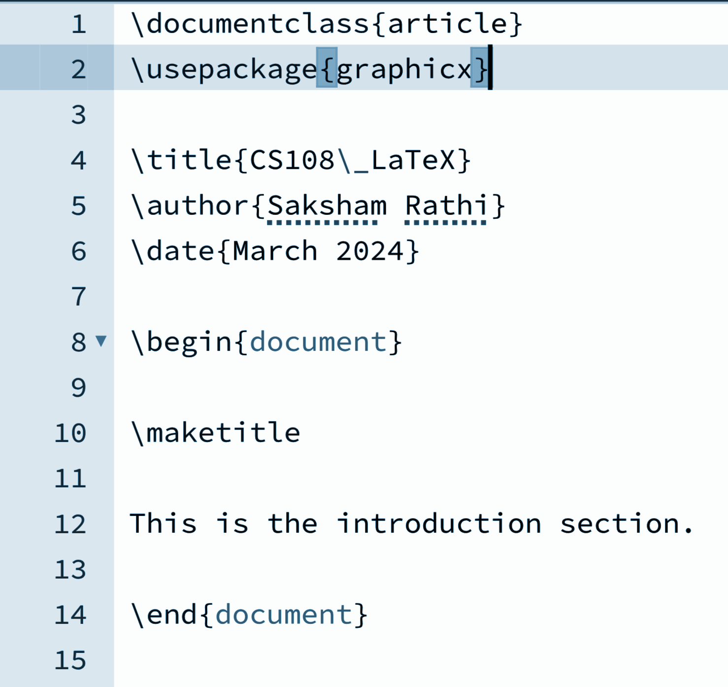
Basic Format
The first line specifies the document class/type. (e.g.: article, book, letter, beamer, report etc.)
\usepackage for including extra packages. (graphicx for inserting images.)
\title: sets the title of the document.
\author: sets the author(s) of the document.
\date: to mention date of creation/last modification.
\begin{}: to mark the beginning of a particular section. {document} for actual content. Always followed by \end{}.
\maketitle: to make the title visible
Check format.tex.

Slide 6
Text Formatting
\textbf{}: To make the text bold.
\textit{}: To write italics text.
\texttt{}: Typewriter text
\underline{}: Underline the text
\emph{}: To emphasize some part of the document. (Typically same as italics.)
\tiny: Reduce font size.
Font Size can be further adjusted using \small, \normalsize, \large, \Large, \LARGE, \huge, \Huge.
Alignment can be adjusted using \begin{flushleft}, \begin{center}, \begin{flushright} and \begin{justify}.
Check text.tex.

Slide 7
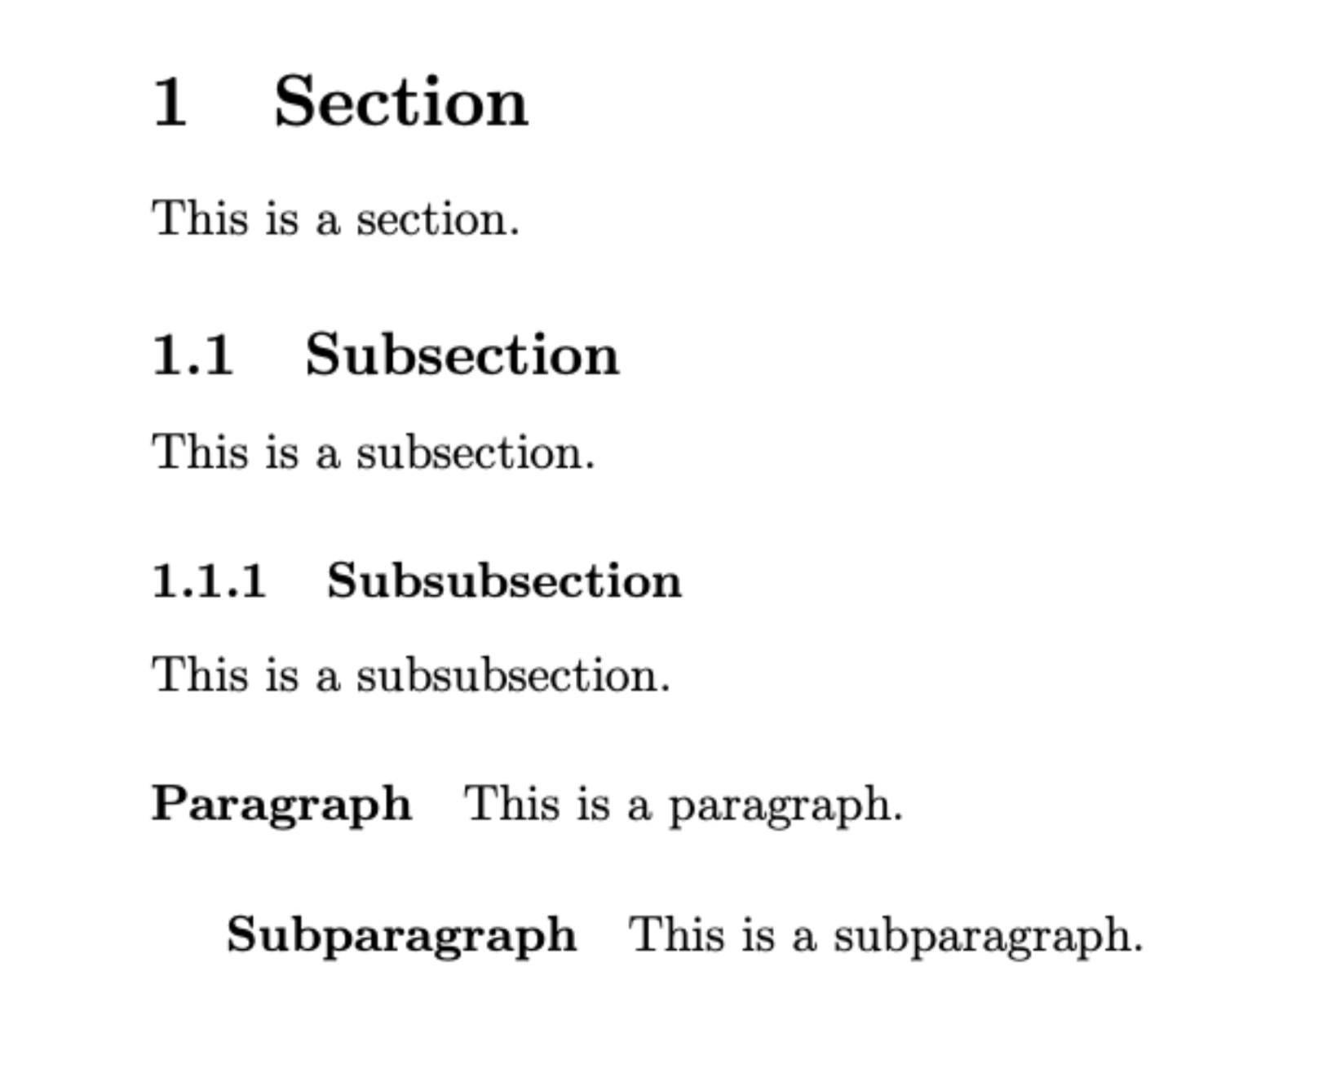
Sections
Way to organize text under various headings:
Chapters
Part
Section
Subsection
Subsubsection
Paragraph
Subparagraph
Section*
Check section.tex

Slide 8
Images
Check image.tex
\usepackage{graphicx}: package for including graphics
\graphicspath{{images/}}: specify the directory containing the images.
\begin{figure}: begin the figure environment. Various options are available. [h] for here, [t] = top, [b] = bottom, [p] = latex will place.
\centering: To place the image at the center.
\includegraphics: To specify the image name/location.
[width=0.75\textwidth] : to specify the the width of the image as compared to the textwidth.
\caption: To specify the text to be displayed.
\label: Can be treated as an id to the image, so that it can be referred.
\ref{}: To refer the image. On clicking it will move us to the image.
\pageref{}: To refer to the page of that image.

Slide 9
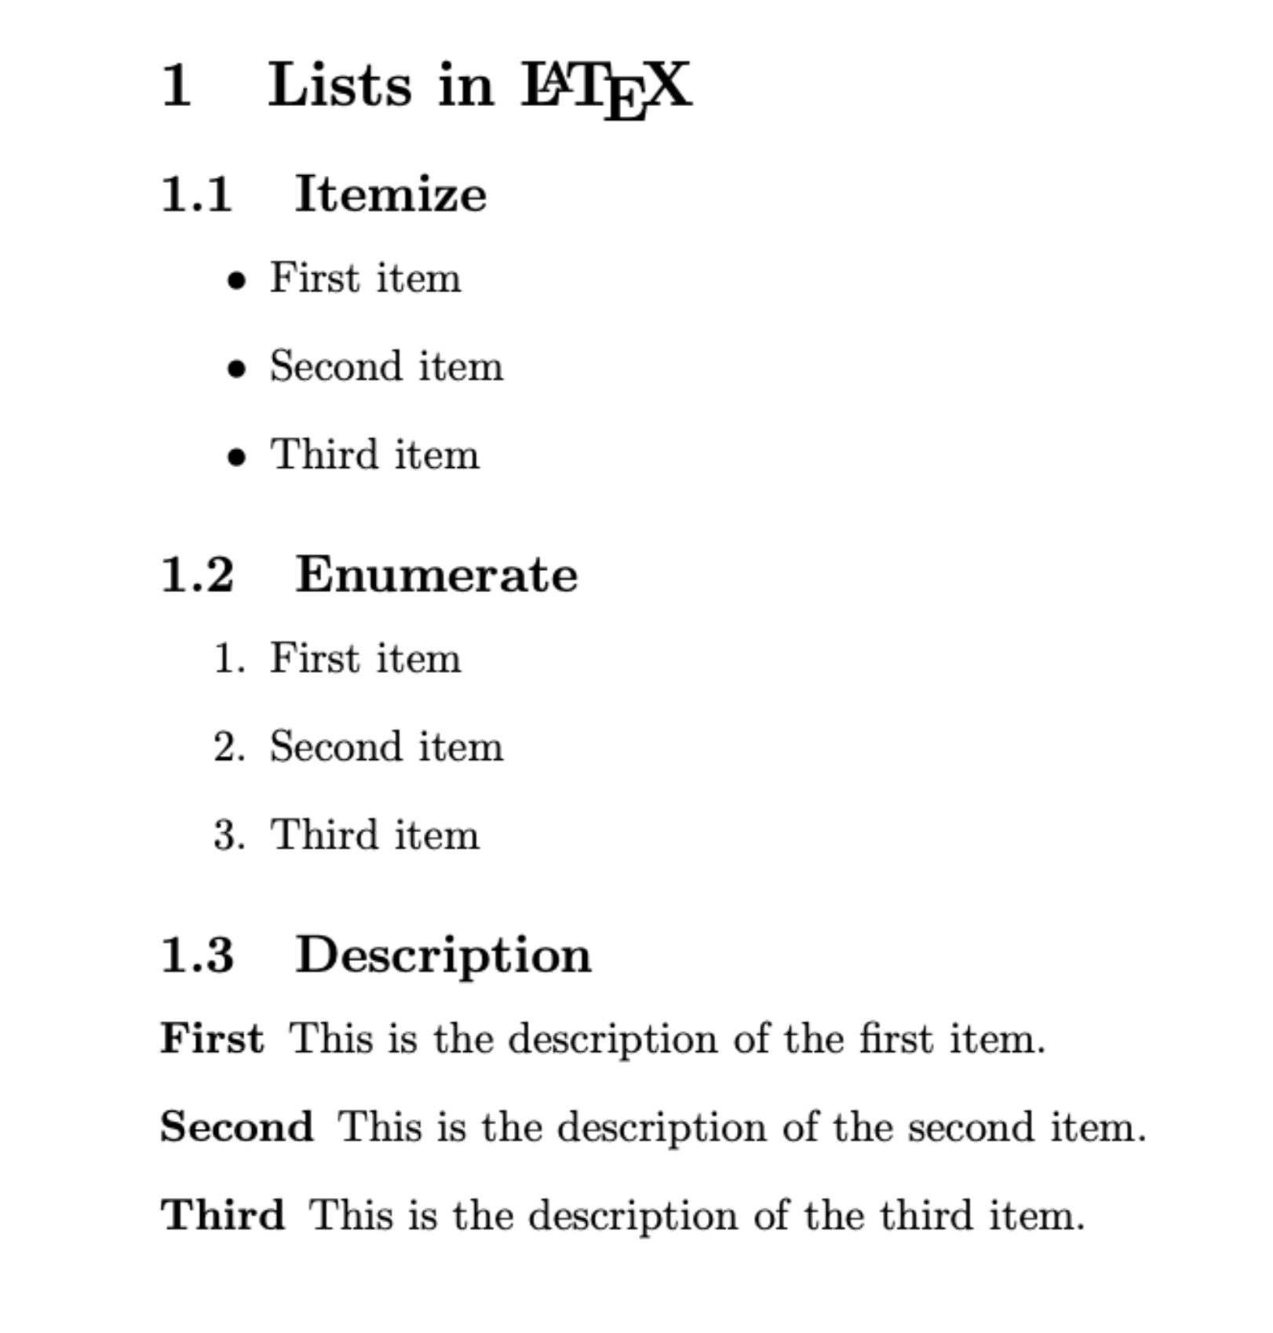
Lists
Various types of lists in LaTeX
Itemize: for bullet points
Enumerate: ordered lists, for numbers in front of list entries
Description: For lists without bullets and numbers.
Check list.tex

Slide 10
Tables
\begin{tabular} for beginning tabular environment.
Various useful packages: table, array, booktabs, multirow. Check table.tex.
\begin{tabular}{|c|c|c|}: Three columns, each separated by a vertical line. If we do not want borders then do {ccc}
\hline: for inserting horizontal lines after header or after rows.
data1 & data2 & data3 \\: column data for each row separated by “&”, new row inserted by \\.
Instead of c in {ccc}, we can also use l (left-aligned), r(right-aligned) and p(paragraph). Width of a particular column can be specified by {|l|r|p{3cm}|} (here, the width of paragraph (3rd column) will be 3cm)
\toprule to start table, \midrule to separate rows, \bottomrule to end table. Different thickness of these lines make the table visually appealing.
\multirow{number_of_rows}{width}{contents}: To merge two rows for a particular column. Width can be set to * to adjust automatically.
\rowcolor to make a particular row coloured. \rowcolor{gray!10}: Uses 10% gray intensity colour for that row.

Slide 11
Maths
Check the use of math packages: amsmath, amsfonts, amssymb and amsthm.
Inline math: using $<math formula>$ within the line.
Display math: using \[\] or \begin{equation}. The first one will not associate an equation number with the formula, but the second one will.
Subscript using _, superscript using ^.
\frac{}{}: for fractions; greek letters: \alpha, \beta, \gamma, \sigma, \Sigma and so on.
Various mathematical operators/functions: \lim, \int, \sin, \cos and so on.
Also, check \begin{cases} for case wise functions.
You can also define theorem environments. Check math.tex.

Slide 12
Functions
In LaTeX, we can define our own functions and commands using \newcommand.
Syntax: \newcommand{\commandname}[numargs]{definition}.
Defined outside the \begin{document} environment.
In the function definition, command line arguments are specified using #1, #2 and so on.
We can even write commands for optional arguments, or arguments having certain default values.
Check functions.tex.

Slide 13
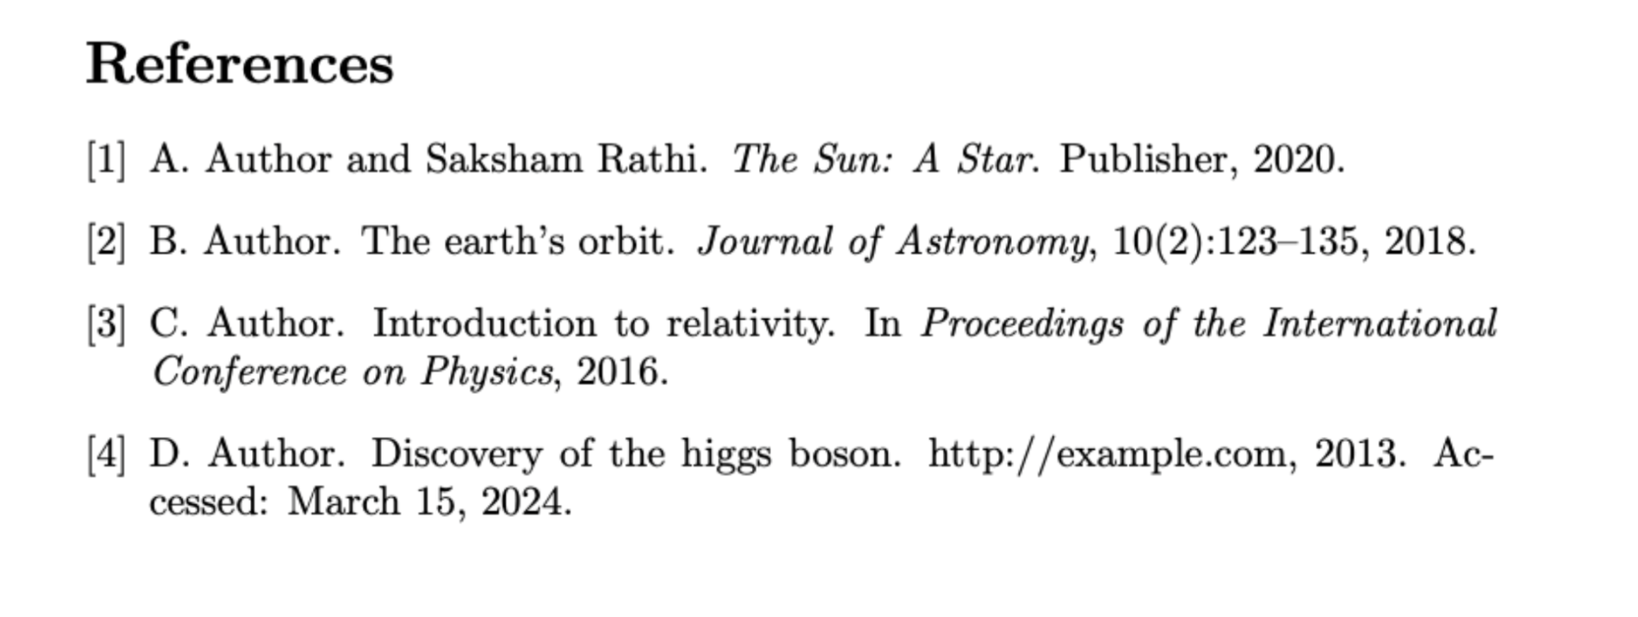
Bibliography
Bibliography can be included in the same .tex file, where your text is present. But that has certain limitations and generally not recommended.
You can write a sample .bib file and then link that to your .tex file. Check biblio.tex and sample.bib.
Use \cite when one has to quote some book/article from the bibliography.
Some of the examples are: book, article, webpages, conference papers and so on.
For detailed reference, check: https://www.overleaf.com/learn/latex/Bibliography_management_in_LaTeX

Slide 14
How to compile LaTeX?
LaTeX and bibliography files can be compiled into the .pdf file through a sequence of 4 commands.
pdflatex myfile: Your tex file is named as myfile.tex. Converts all the basic formula and text into pdf. But does not know what the cite commands are for. Consequently, instead of numbers, we have [?] in the pdf, wherever we cite. Writes all occurrences of cite in myfile.aux.
bibtex myfile: Let’s say your bibtex file is named as sample.bib. The .aux file will get this name from the \bibliography{}. Looks up the citations from myfile.aux and the \bibliographystyle{} to write all the bibliography list to myfile.bbl. No changes to the output pdf file.
pdflatex myfile: Insert the contents of myfile.bbl to the pdf. But the citations are still not correct [?].
pdflatex myfile: Citations are replaced by the corresponding labels.
Finally, myfile.pdf is generated. Check the compilation folder and the script present there. Run each command one by one and see how the pdf changes and the extra files created after each step.

Slide 15
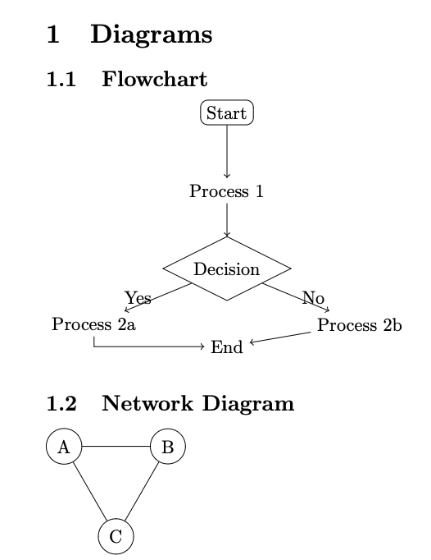
Tikz
An important package for creating diagrams, plots, charts and various other objects.
Check tikz.tex
For basic introduction: https://www.overleaf.com/learn/latex/TikZ_package
For detailed reference: https://tikz.dev/
Another useful tool: geogebra

Slide 16
Exercises
Check the exercises folder and generate those pdfs using latex and bibtex.

Slide 17
THANK YOU!!!
If you wish to write “LaTeX” in LaTeX, then write \LaTeX.

